Slide 1
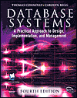
Lecture Four
Relational Algebra and Relational Calculus
Based on Chapter Four of this book:
Database Systems: A Practical Approach to Design, Implementation and Management
International Computer Science S.
Carolyn Begg, Thomas Connolly

Slide 2
Lecture 4 - Objectives
Meaning of the term relational completeness.
How to form queries in relational algebra.
Categories of relational DML.

Slide 3
Introduction
Relational algebra and relational calculus are formal languages associated with the relational model.
Informally, relational algebra is a (high-level) procedural language and relational calculus a non-procedural language.
However, formally both are equivalent to one another.
A language that can produce any relation that can be derived using relational calculus is relationally complete.

Slide 4
Relational Algebra
Relational algebra operations work on one or more relations to define another relation without changing the original relations.
Both operands and results are relations, so output from one operation can become input to another operation.
Allows expressions to be nested, just as in arithmetic. This property is called closure.

Slide 5
Relational Algebra
5 basic operations in relational algebra: Selection, Projection, Cartesian product, Union, and Set Difference.
These perform most of the data retrieval operations needed.
Also have Join, Intersection, and Division operations, which can be expressed in terms of 5 basic operations.

Slide 6
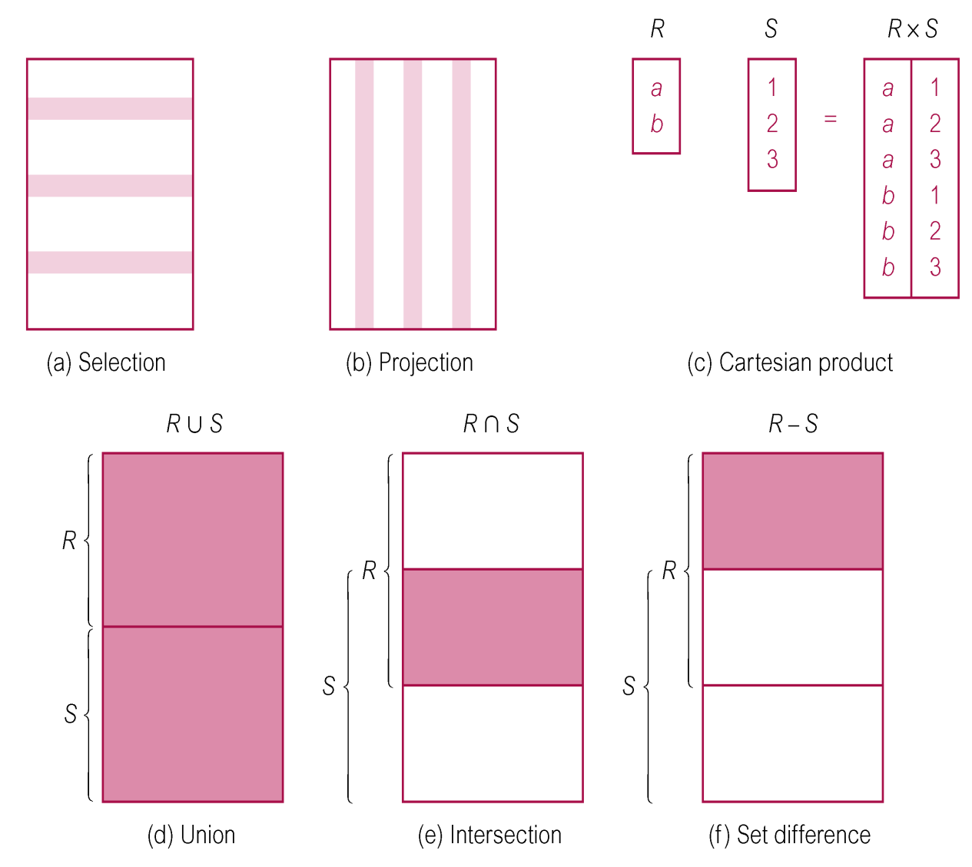
Relational Algebra Operations

Slide 7
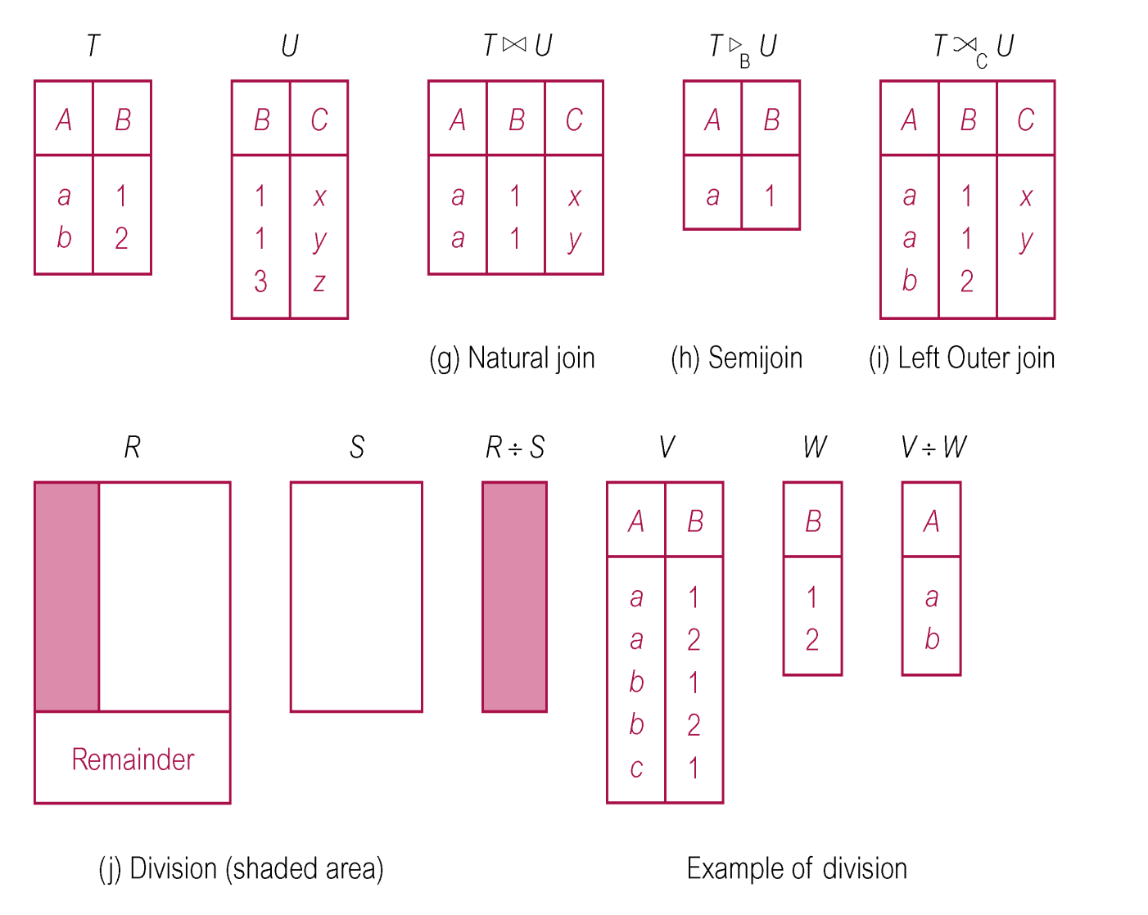
Relational Algebra Operations

Slide 8
Selection (or Restriction)
σ_{predicate} (R)
  Works on a single relation R and defines a relation that contains only those tuples (rows) of R that satisfy the specified condition (predicate).

Slide 9
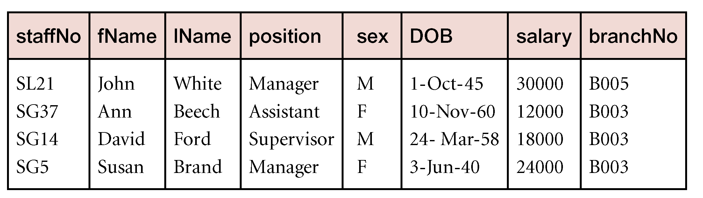
Example - Selection (or Restriction)
List all staff with a salary greater than £10,000.
  σ_{salary > 10000} (Staff)

Slide 10
Projection
Π_{col1, . . . , coln}(R)
  Works on a single relation R and defines a relation that contains a vertical subset of R, extracting the values of specified attributes and eliminating duplicates.

Slide 11
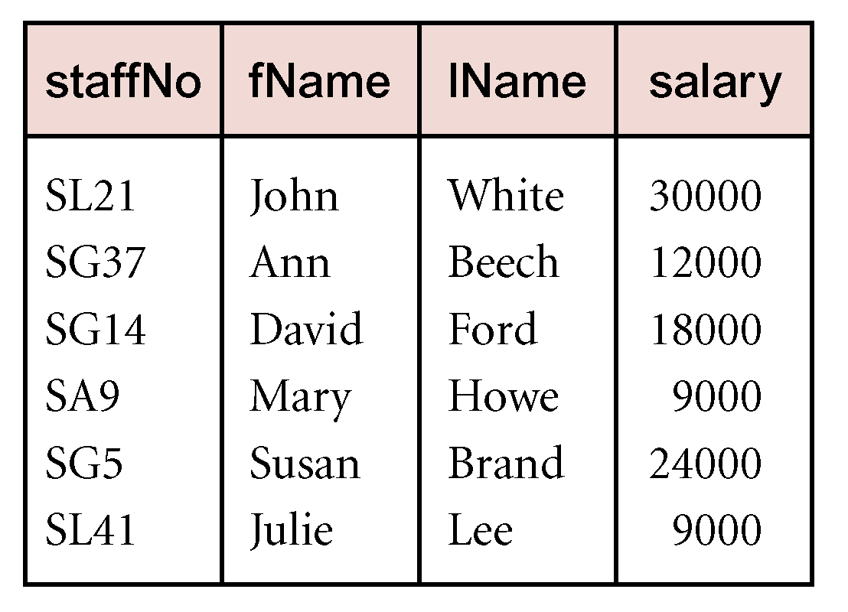
Example - Projection
Produce a list of salaries for all staff, showing only staffNo, fName, lName, and salary details.
  Π_{staffNo, fName, lName, salary}(Staff)

Slide 12
Union
R ∪ S
  Union of two relations R and S defines a relation that contains all the tuples of R, or S, or both R and S, duplicate tuples being eliminated.
  R and S must be union-compatible.
If R and S have I and J tuples, respectively, union is obtained by concatenating them into one relation with a maximum of (I + J) tuples.
Notes:
SELECT city FROM Branch
UNION
SELECT city FROM PropertyForRent;

Slide 13
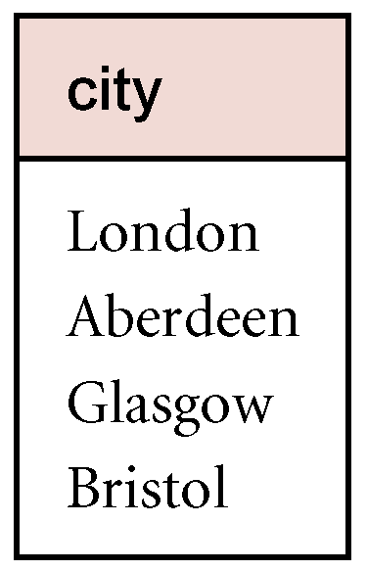
Example - Union
List all cities where there is either a branch office or a property for rent.
  Π_{city}(Branch) ∪ Π_{city}(PropertyForRent)

Slide 14
Set Difference
R – S
  Defines a relation consisting of the tuples that are in relation R, but not in S.
  R and S must be union-compatible.
Notes:
SELECT city FROM Branch
EXCEPT
SELECT city FROM PropertyForRent;

Slide 15
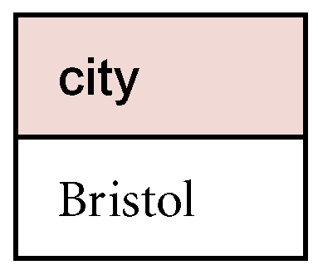
Example - Set Difference
List all cities where there is a branch office but no properties for rent.
  Π_{city}(Branch) – Π_{city}(PropertyForRent)

Slide 16
Intersection
R ∩ S
  Defines a relation consisting of the set of all tuples that are in both R and S.
  R and S must be union-compatible.
Expressed using basic operations:
  R ∩ S = R – (R – S)

Slide 17
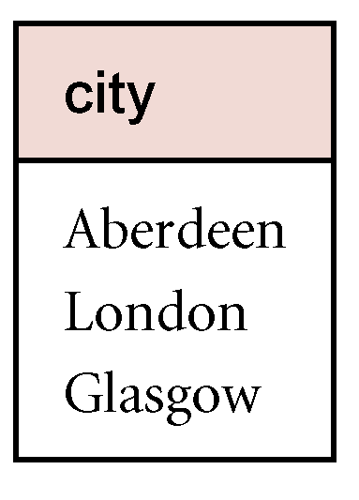
Example - Intersection
List all cities where there is both a branch office and at least one property for rent.
  Π_{city}(Branch) ∩ Π_{city}(PropertyForRent)

Slide 18
Cartesian product
R X S
  Defines a relation that is the concatenation of every tuple of relation R with every tuple of relation S.

Slide 19
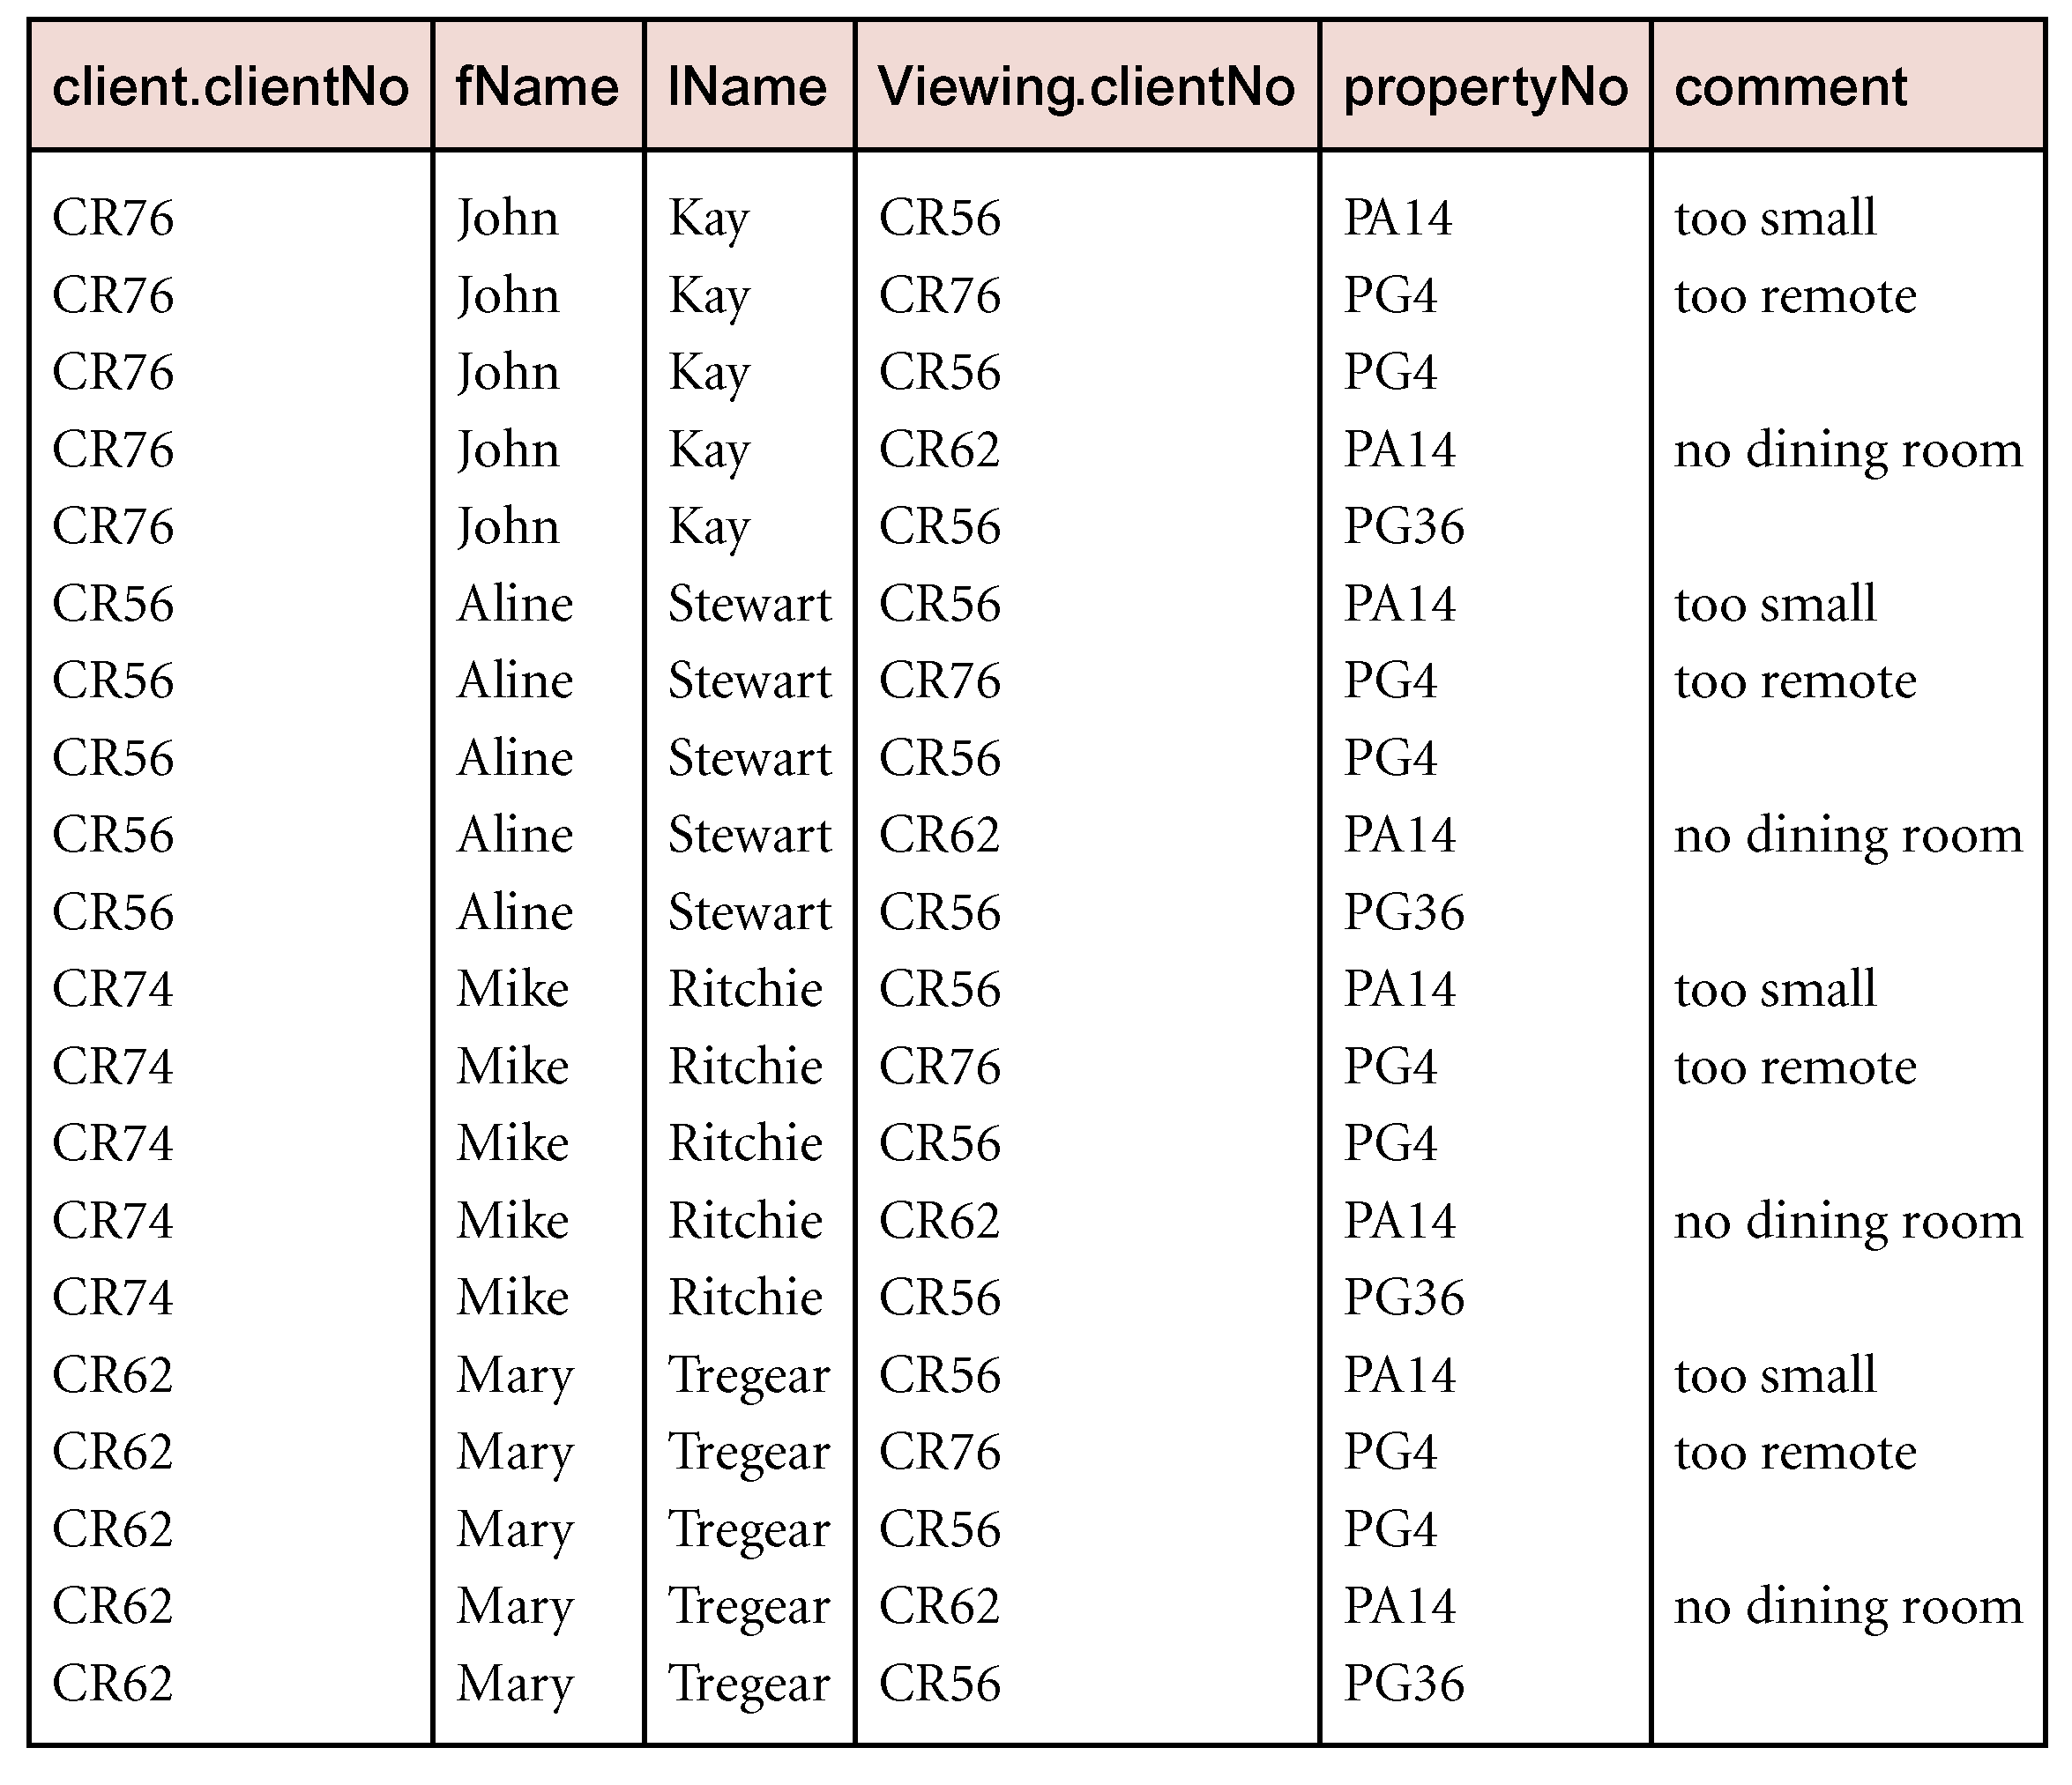
Example - Cartesian Product
List the names and comments of all clients who have viewed a property for rent.
  (Π_{clientNo, fName, lName}(Client)) X (Π_{clientNo, propertyNo,comment} (Viewing))

Slide 20
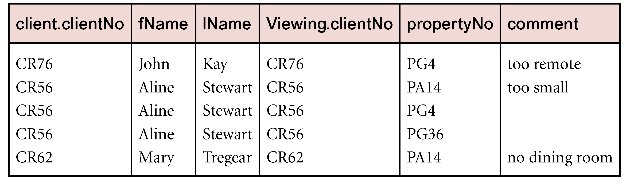
Example - Cartesian Product and Selection
Use selection operation to extract those tuples where Client.clientNo = Viewing.clientNo.
  σClient.clientNo = viewing.clientNo((∏_{clientNo,fName,lName}(Client)) Χ (∏_{clientNo,propertyNo,comment}(Viewing)))
Cartesian product and Selection can be reduced to a single operation called a Join.
Notes:
SELECT Client.clientNo, Client.fName, Client.lName, Viewing.propertyNo, Viewing.comment
FROM Client
CROSS JOIN Viewing
WHERE Client.clientNo = Viewing.clientNo;

Slide 21
Join Operations
Join is a derivative of Cartesian product.
Equivalent to performing a Selection, using join predicate as selection formula, over Cartesian product of the two operand relations.
One of the most difficult operations to implement efficiently in an RDBMS and one reason why RDBMSs have intrinsic performance problems.

Slide 22
Join Operations
Various forms of join operation
  Theta join
  Equijoin (a particular type of Theta join)
  Natural join
  Outer join
  Semijoin

Slide 23
Theta join (θ-join)
R _{F}S
  Defines a relation that contains tuples satisfying the predicate F from the Cartesian product of R and S.
  The predicate F is of the form R.a_{i} θ S.b_{i} where θ may be one of the comparison operators (<, ≤, >, ≥, =, ≠).
Notes:
Theta Join: Combines rows based on any condition.
Equijoin: A type of theta join where the condition is equality.
Natural Join: Automatically joins based on columns with the same name.
Outer Join: Includes all rows from one or both tables, with NULLs for non-matches.
Semijoin: Returns rows from the first table that have matches in the second table but doesn’t include columns from the second table.

Slide 24
Theta join (θ-join)
Can rewrite Theta join using basic Selection and Cartesian product operations.
    R _{F}S = σ_{F}(R Χ S)
Degree of a Theta join is sum of degrees of the operand relations R and S. If predicate F contains only equality (=), the term Equijoin is used.

Slide 25
Example - Equijoin
List the names and comments of all clients who have viewed a property for rent.
  (Π_{clientNo,fName,lName}(Client)) Client.clientNo = Viewing.clientNo (Π_{clientNo,propertyNo,comment}(Viewing))

Slide 26
Natural Join
R S
  An Equijoin of the two relations R and S over all common attributes x. One occurrence of each common attribute is eliminated from the result.

Slide 27
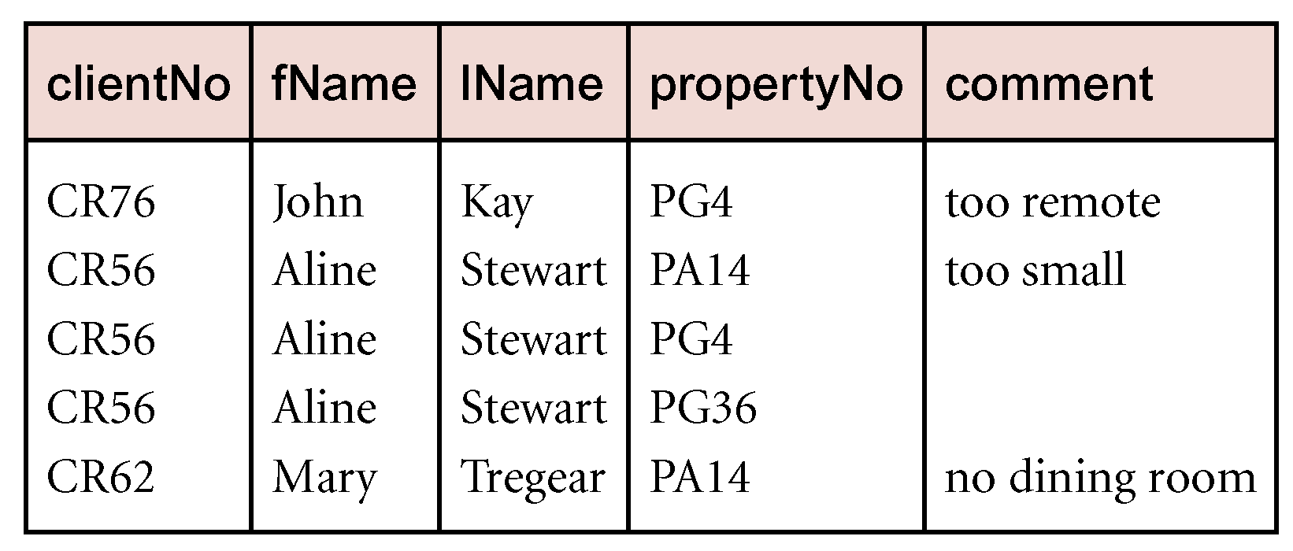
Example - Natural Join
List the names and comments of all clients who have viewed a property for rent.
  (Π_{clientNo,fName,lName}(Client)) (Π_{clientNo,propertyNo,comment}(Viewing))

Slide 28
Outer join
To display rows in the result that do not have matching values in the join column, use Outer join.
R S
  (Left) outer join is join in which tuples from R that do not have matching values in common columns of S are also included in result relation.

Slide 29
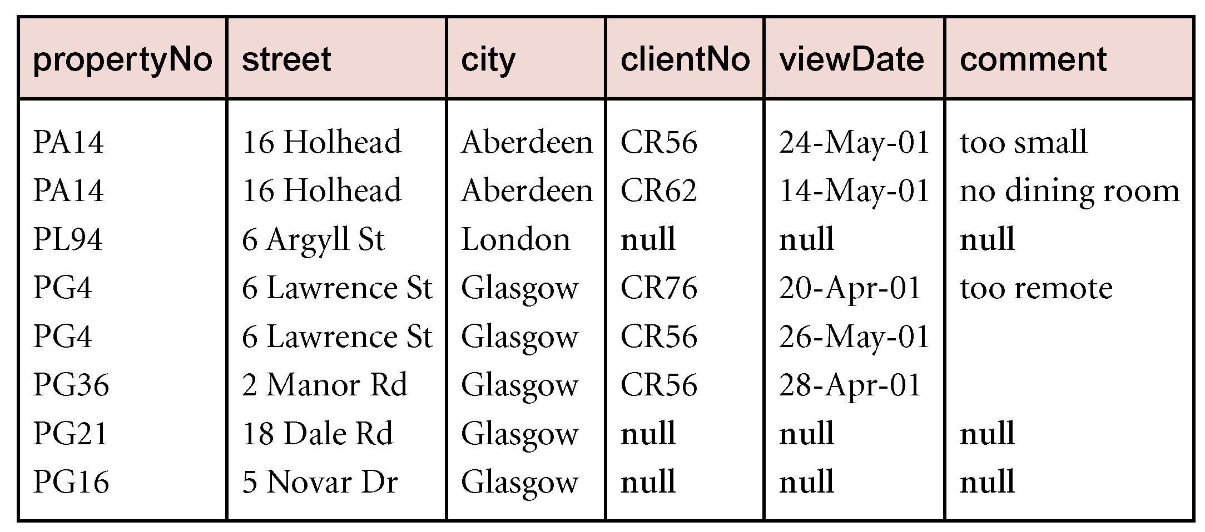
Example - Left Outer join
Produce a status report on property viewings.
  Π_{propertyNo,street,city}(PropertyForRent) Viewing

Slide 30
Other Languages
Transform-oriented languages are non-procedural languages that use relations to transform input data into required outputs (e.g. SQL).
Graphical languages provide user with picture of the structure of the relation. User fills in example of what is wanted and system returns required data in that format (e.g. QBE).

Slide 31
Other Languages
4GLs can create complete customized application using limited set of commands in a user-friendly, often menu-driven environment.
Some systems accept a form of natural language, sometimes called a 5GL, although this development is still a an early stage.

